Slide 1
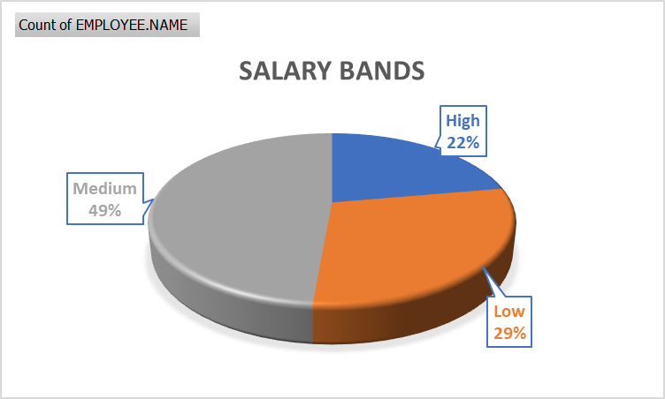
Deep Dive – Cluster of High Satisfied Employees
Out of those 72 employees,
63 employees are more than 2 years old in the company.
This means old employees are more dedicated and satisfied with the company.
BALL VALVE DIVISION
HO PUNE DIVISION
INDAPUR DIVISION
56 employees most of them are in Low and medium salary band.
Means Satisfaction has no correlation with Salary.
61 are from only three divisions i.e. Ball Valve, HO Pune and Indarpur division.

Slide 2
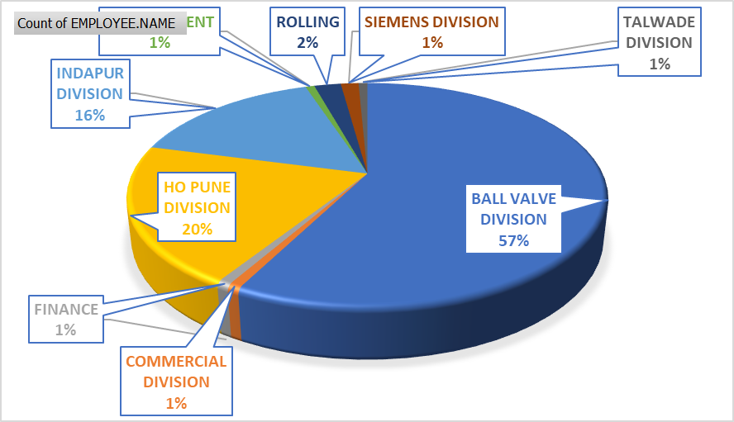
Deep Dive – Cluster of Low Satisfied Employees
57% of these employees are from Ball Valve Division.
Key reason of their dis-satisfaction is work over load and distribution of task.
Relook the KPIs, skill mapping & opportunity for better career prospects etc.
To mitigate the risk of their attrition, HR must bring various initiatives like training workshops, counselling, role change etc.

